Slide 1
Kyocera Driver Installation
Basic instruction to add a printer to computer using standard defaults

Slide 2
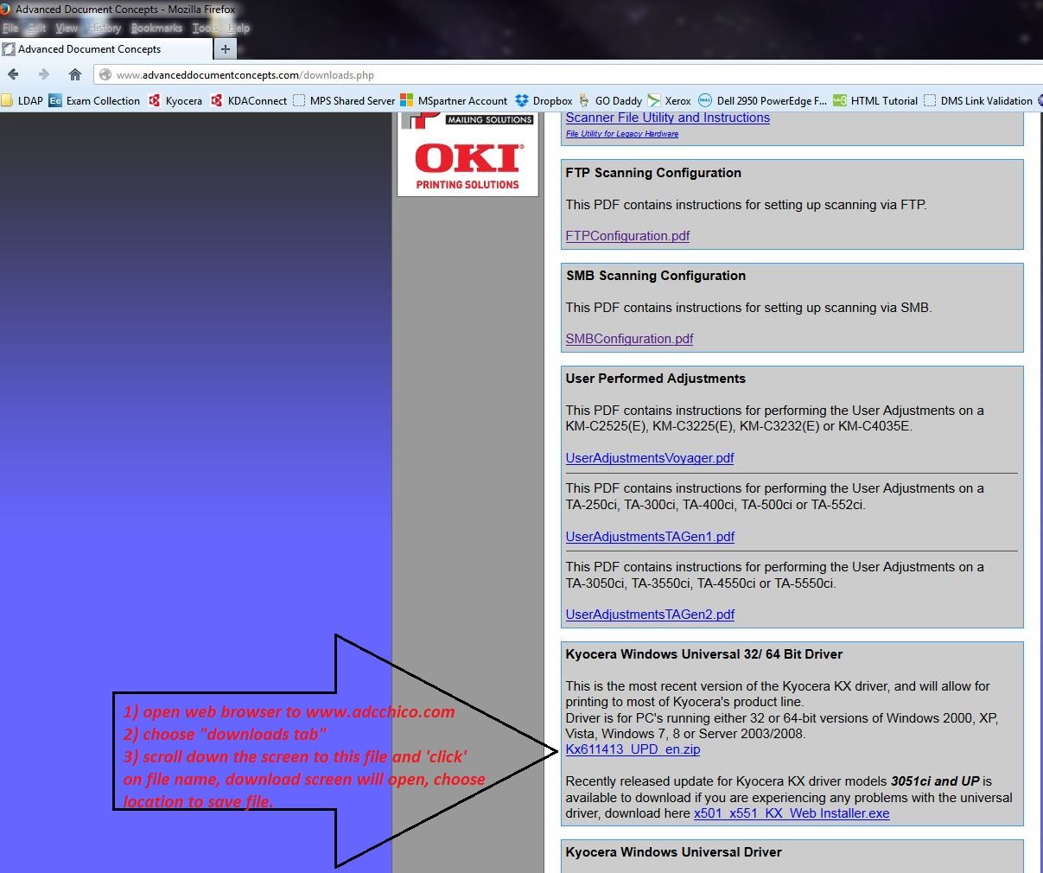
Download driver from our website
www.adcchico.com

Slide 3
Driver installation

Slide 4
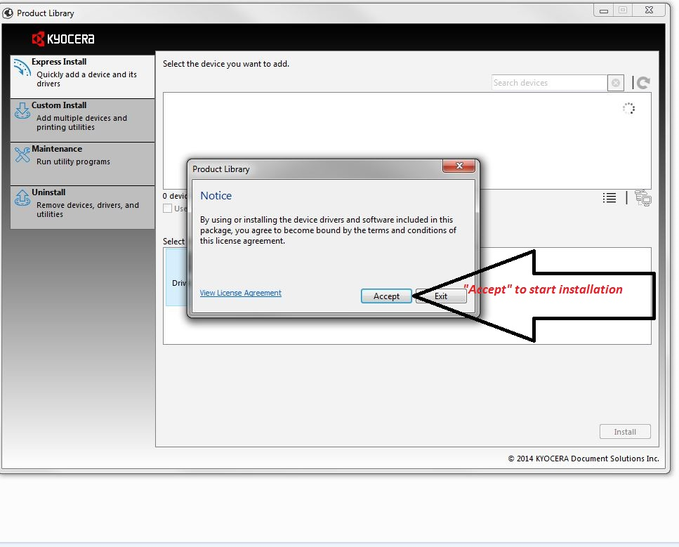

Slide 5
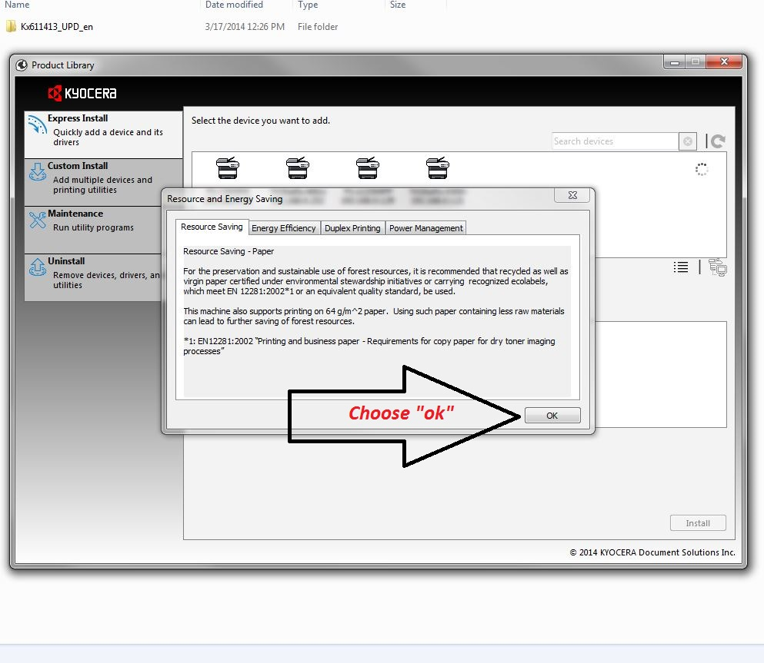

Slide 6
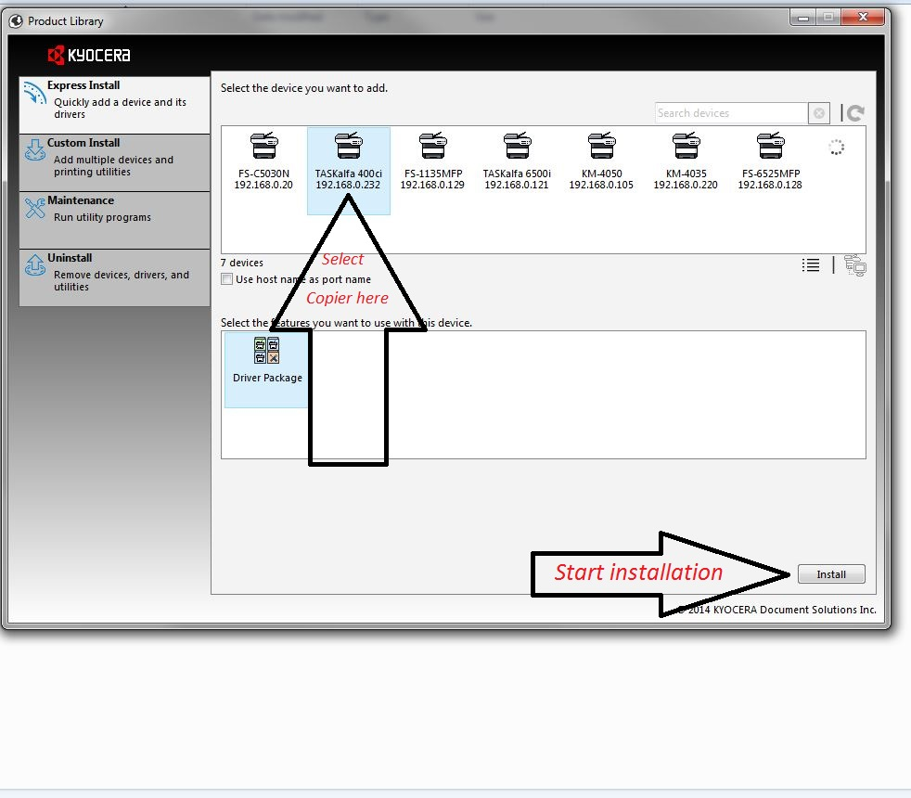

Slide 7
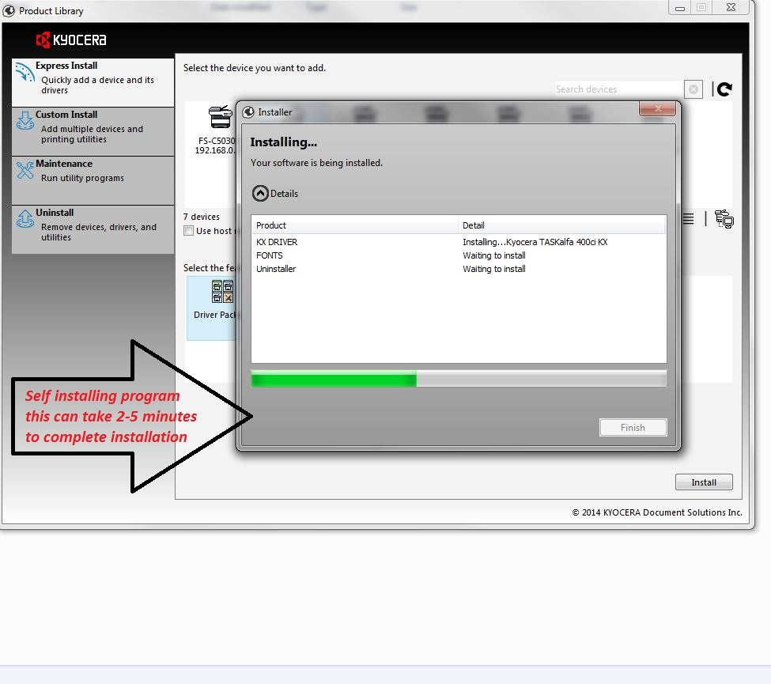

Slide 8
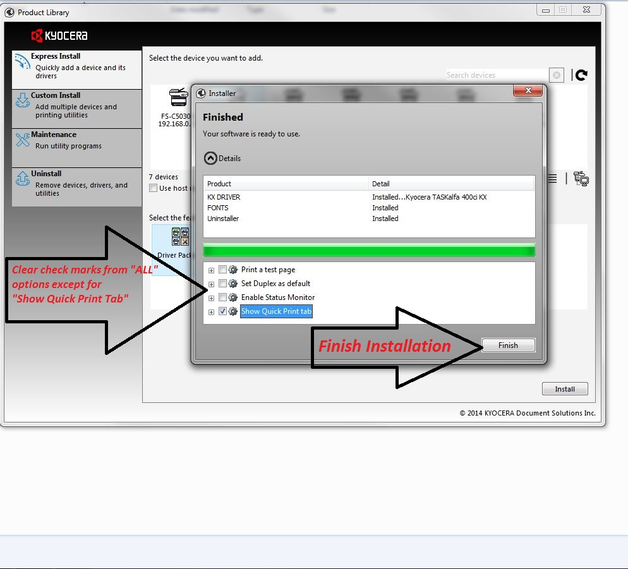

Slide 9
Advance Settings & Administration
The next few slides will help to create multiple print profiles and advance settings for clients.

Slide 10
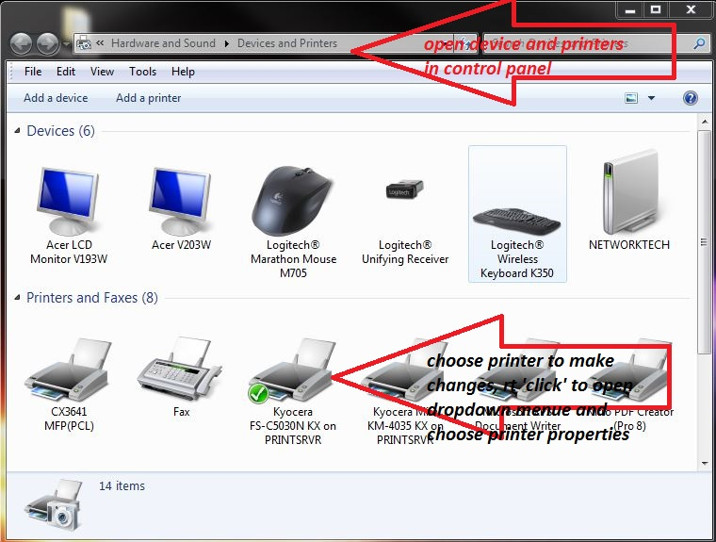
Special instructions for multiple printers to same user. Used for clients with color copiers and for clients that want to track user printing/ copying.
Open control panel and choose icon for “device and printers”

Slide 11
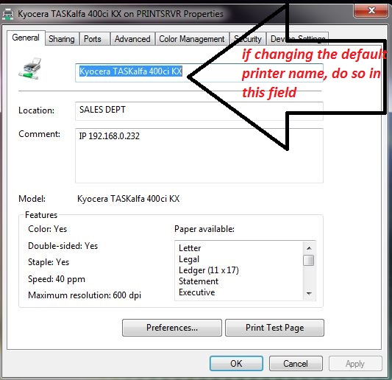
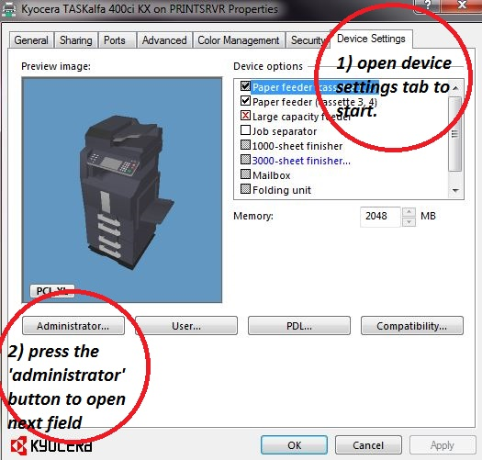
Printer properties tab, used to change default printer name and access additional property settings i.e. “device settings” & “administrator”

Slide 12
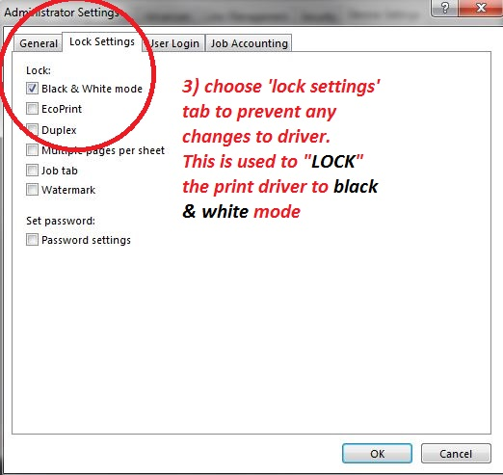
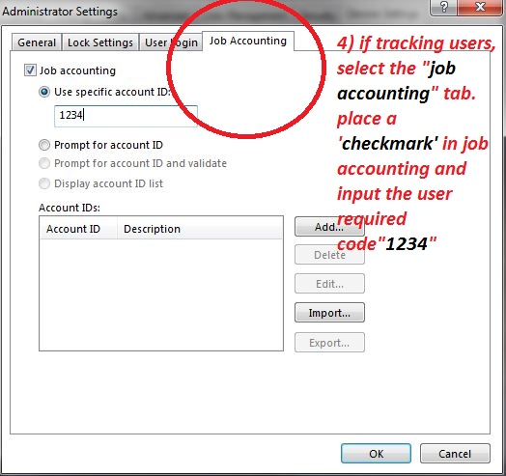
Administrator settings allows user to “LOCK” driver to certain functions only, or to enable the “job accounting” codes if tracking print/ copy usage.

